Slide 1
Company Sales DATA ANALYSIS
-ANIKET CHOWDHURY

Slide 2
Business Objectives
To identify the factors affecting overall sales and profit of the business.
Softwares Used
Python
Tableau

Slide 3
Business problems
What product had the highest average gross sales per unit sold?
Which different government sectors had what statistical summary of profits and sales?
What product had the lowest profit margin percentage?
Which product line and country combination resulted in the most units sold?
What month had the highest profit margin percentage overall across products?
Which region had the largest difference between average manufacturing price and sale price for the Velo product?
What was the most common number of units sold per order for the Amarilla product?
What was the highest single profit earned from one order of the Montana product?
Which product had the smallest variance in sale prices per unit over time?
What segment had the highest total profit margin for the Paseo product in Germany?
What product had the lowest profit margin percentage?
Which country had the highest total profit for the Paseo product line?
What country had the lowest total discounts applied for the VTT product?
What year had the highest average number of units sold per order for the Montana product?
Comparison of sales vs gross sales across different regions.
Influence of discounts on the amount of units sold.
What is the number of products sold in each segment?
Did the number of orders correlate with total profit by country?
What % of sales came from the midmarket segment overall?
What was the most profitable order across all products?
Did discounts impact profit margin percentage?
How did manufacturing prices compare to sale prices by product?
Was profit significantly lower than gross sales for any products?
What sales thresholds were met by quarter and year?
What customer segments and products have emerging growth trends?

Slide 4
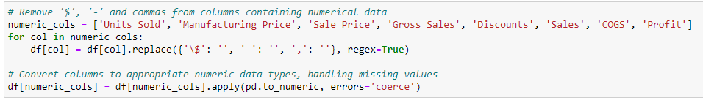
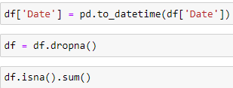
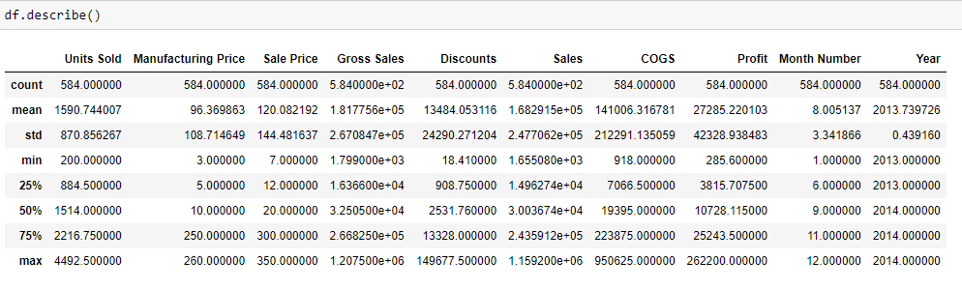
Data Pre-Processing

Slide 5
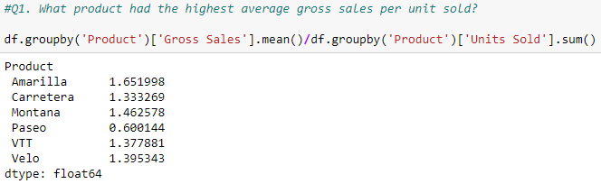
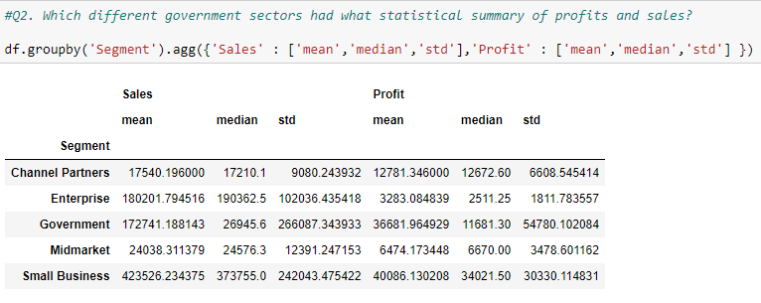
Questions 1-2
Amarilla has the highest average gross sales per unit sold.

Slide 6
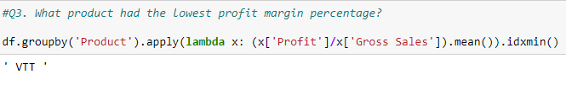
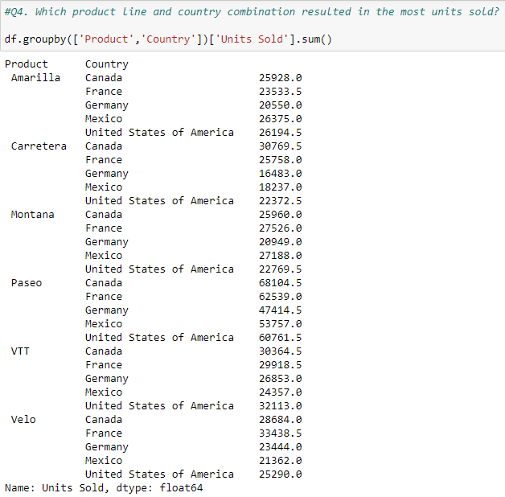
Questions 3-4
Paseo and Canada combination resulted in the most units sold.

Slide 7
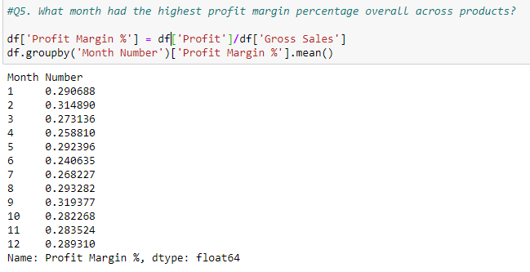
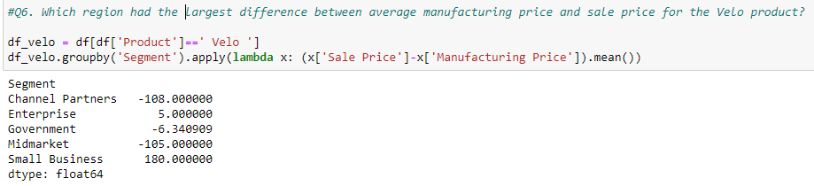
Questions 5-6
September month had the highest profit margin percentage overall across products.

Slide 8
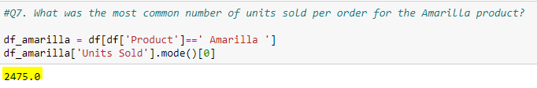
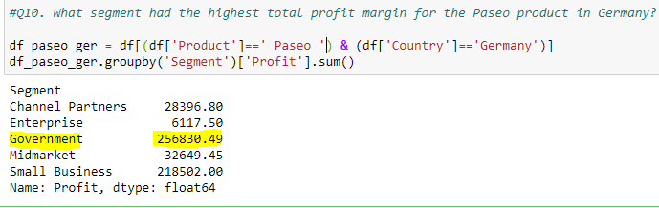
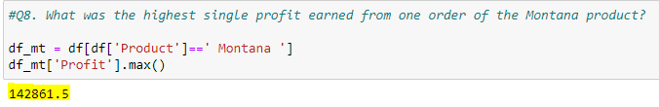
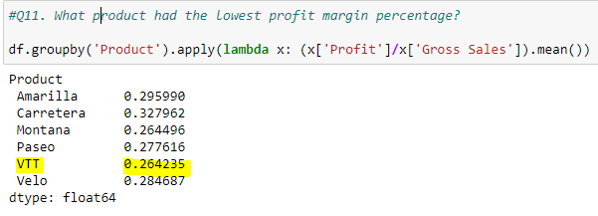
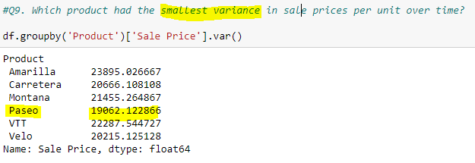
Questions 7-11

Slide 9
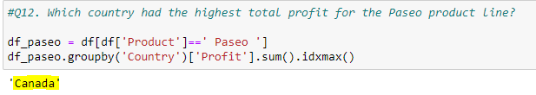
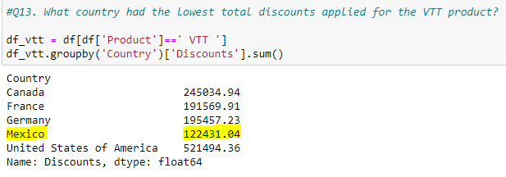
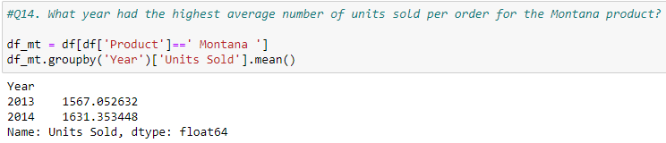
Questions 12-14

Slide 10
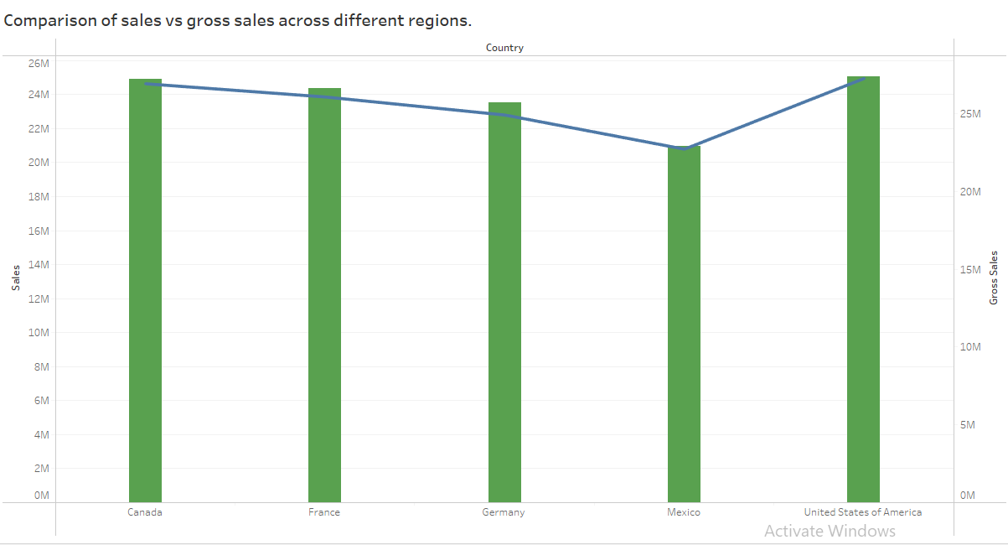
Question 15

Slide 11
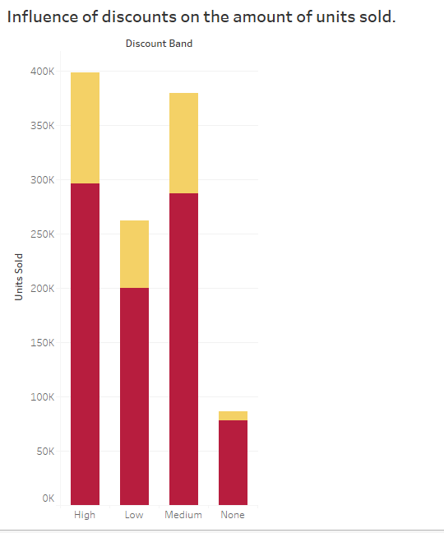
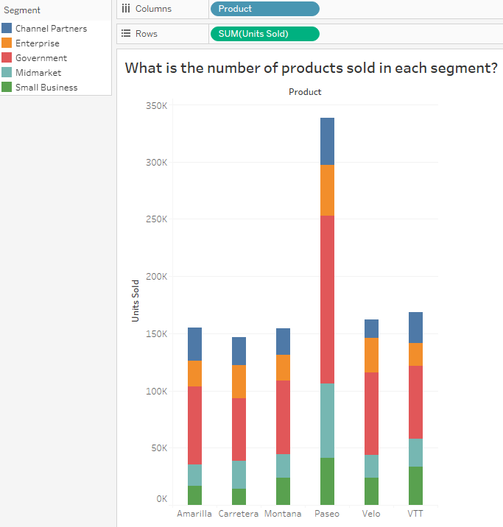
Questions 16-17

Slide 12
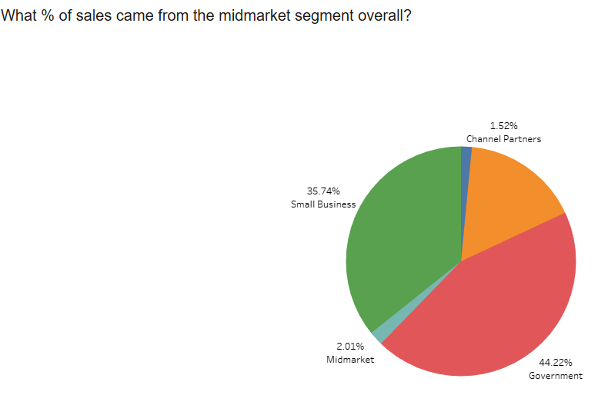
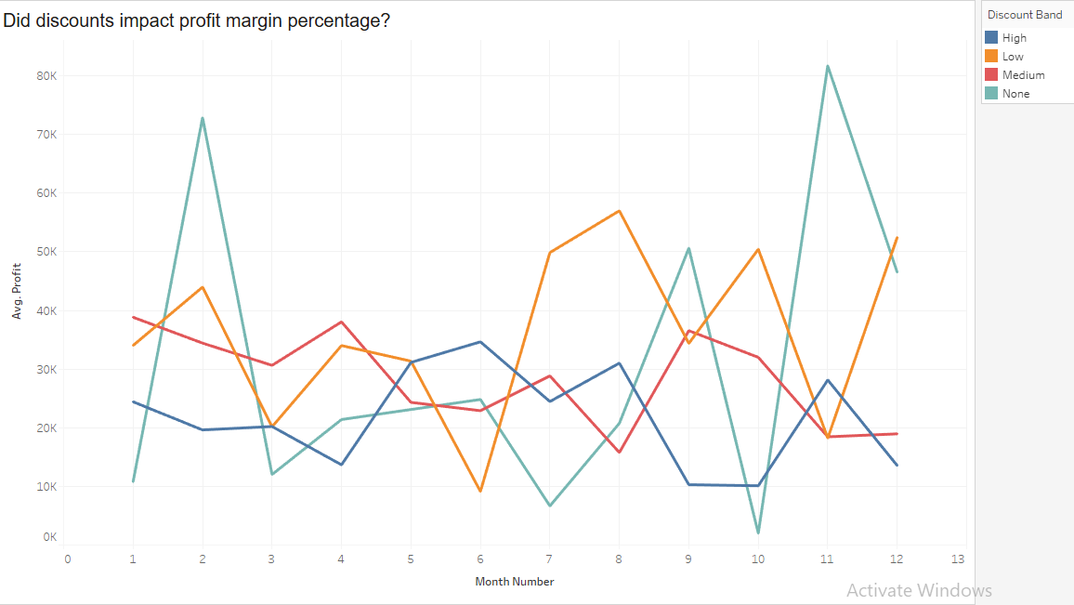
Questions 18-19

Slide 13
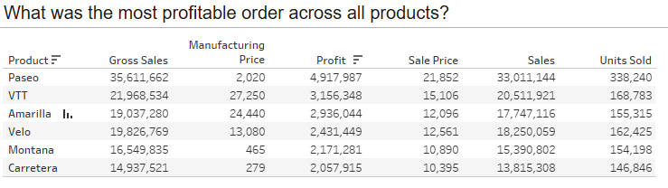
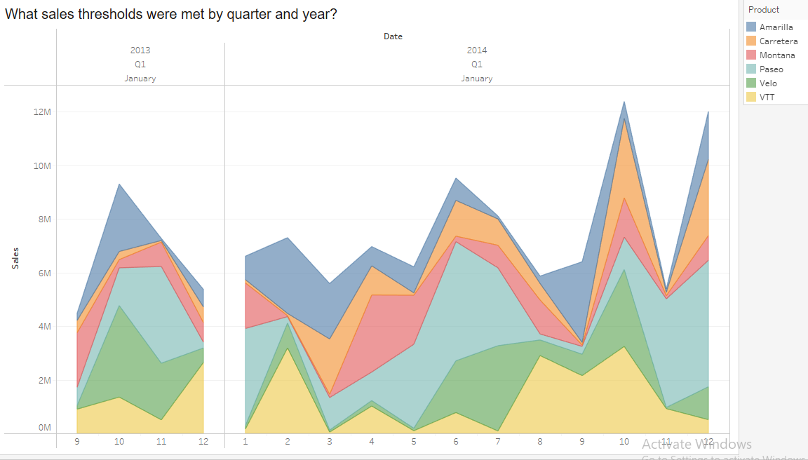
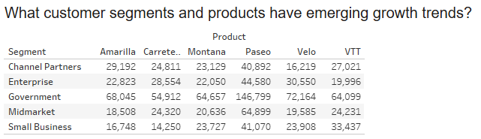
Questions 20-22

Slide 14
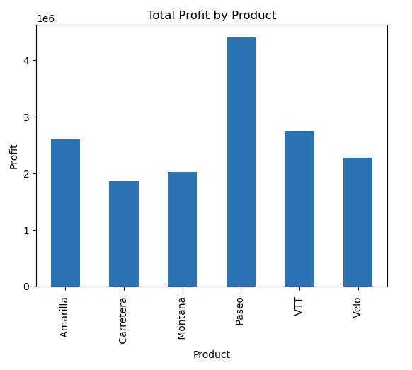
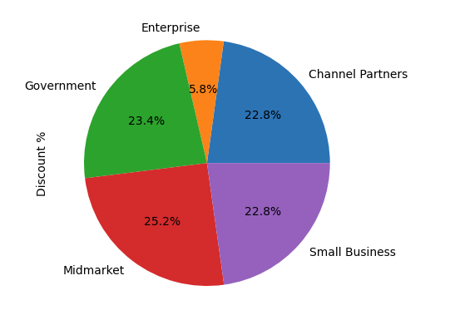
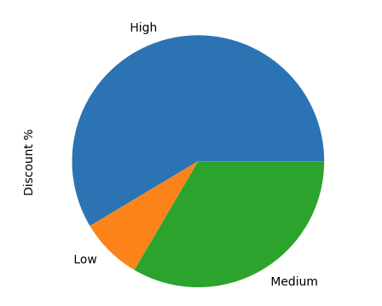
Additional visualizations pt-1

Slide 15
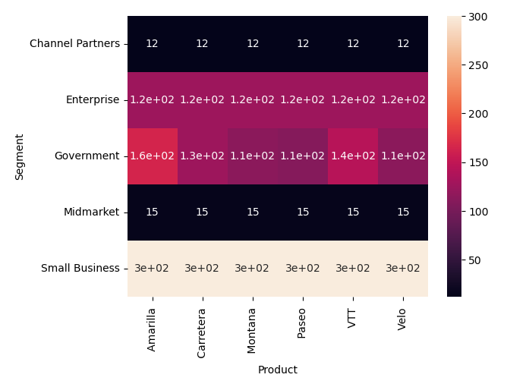
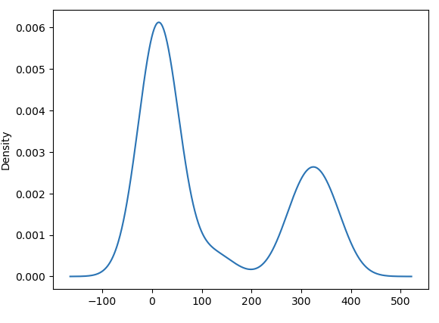
Additional visualizations pt-2

Slide 16
conclusion
Sales get majorly affected by holiday seasons.
There’s a huge gap b/w gross sales and profit.
Products are majorly invested through government sectors.
Paseo is the leading product in terms of profit, gross sales and units sold.
Canada is the place with highest number of units sold.
VTT has the lowest profit margin %age.
Government segment has emerging growth trends.

Slide 17
THANK YOU

